Slide 1
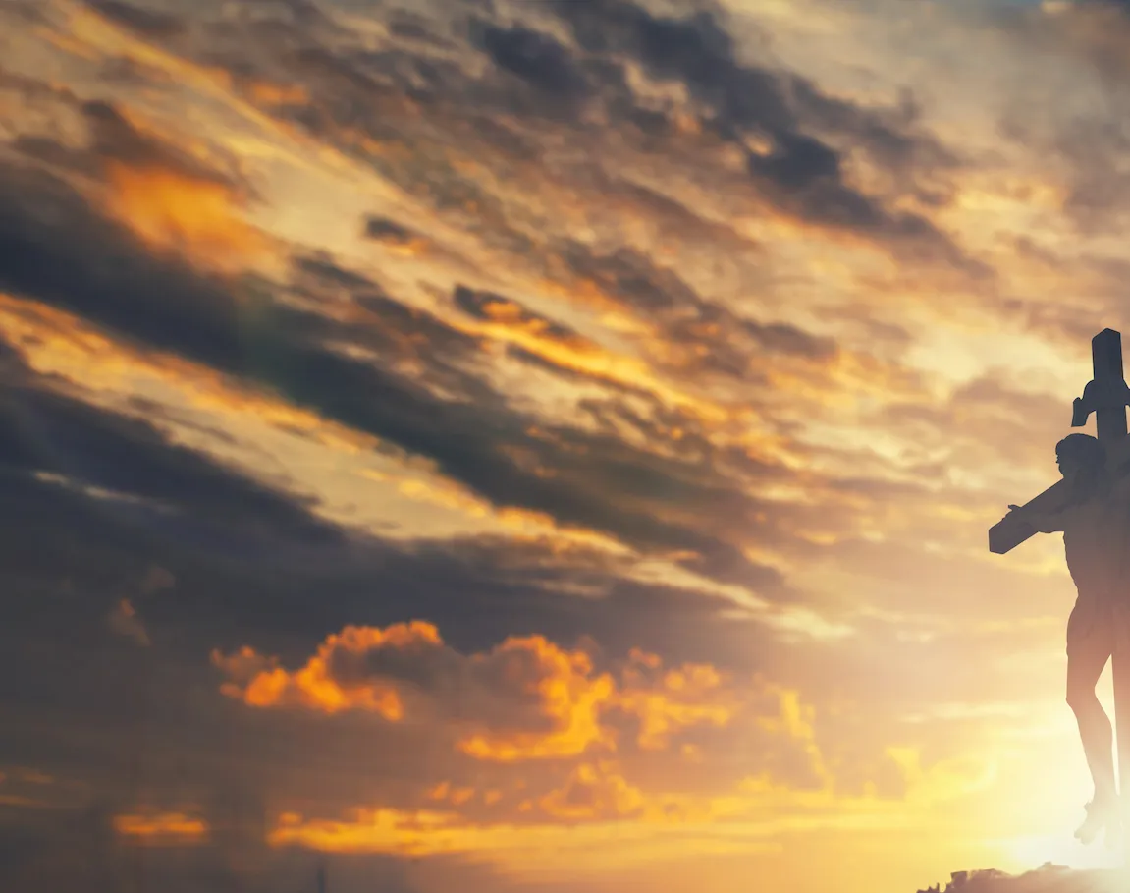
America the Beautiful

Slide 2
G D
O beautiful for spacious skies,
D7 G
for amber waves of grain
D
For purple mountain majesties,
A A7 D D7
above the fruited plain!

Slide 3
G D
America! America!
D7 G
God shed his grace on thee
C G
And crown thy good with brotherhood,
C D7 G
from sea to shining sea!

Slide 4
G D
O beautiful for pilgrim feet,
D7 G
whose stern impassioned stress
D
A thoroughfare of freedom beat,
A A7 D D7
across the wilderness!

Slide 5
G D
America! America!
D7 G
God mend thine every flaw
C G
Confirm thy soul in self-control,
C D7 G
Thy liberty in law!

Slide 6
G D
O beautiful for patriot dream,
D7 G
that sees beyond the years
D
Thine alabaster cities gleam,
A A7 D D7
undimmed by human tears!

Slide 7
G D
America! America!
D7 G
God shed his grace on thee
C G
And crown thy good with brotherhood,
C D7 G
from sea to shining sea!
END

